Slide 1
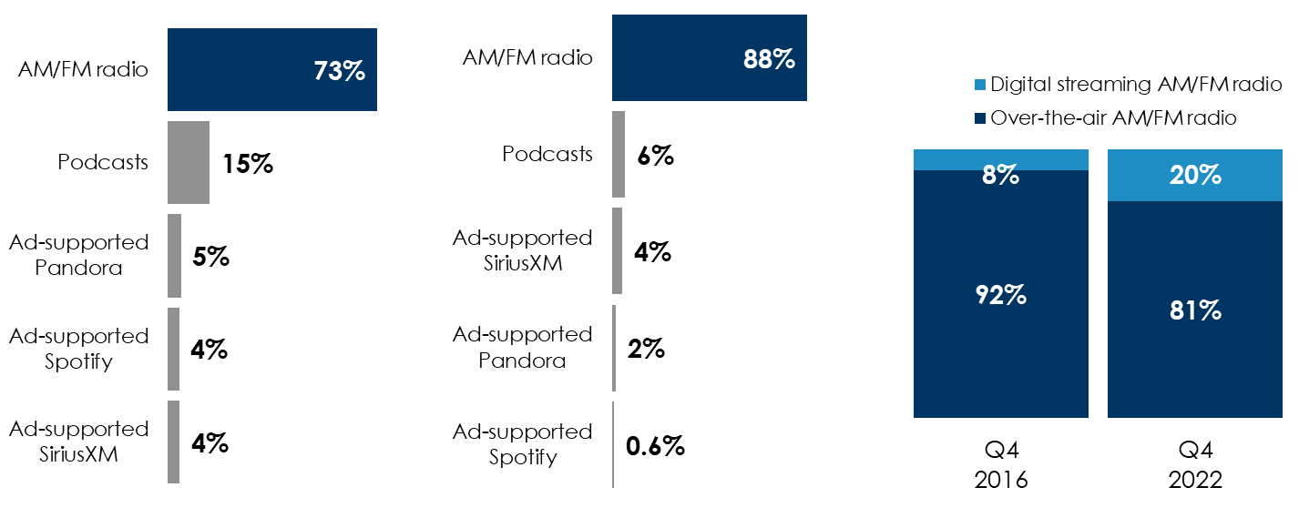
Edison’s “Share Of Ear” Q4 2022: AM/FM Radio Dominates Ad-Supported Time Spent And Streaming Is Now 20% Of AM/FM Radio Listening
Streaming surges as a percentage of total AM/FM radio listening; 20% of 25-54 listening occurs via streaming
AM/FM radio dominates ad-supported audio
In the car, AM/FM radio rules ad-supported audio
Share of ad-supported audio time spent among persons 18+
AM/FM radio’s share of ad-supported audio in the car among persons 18+
Share of audio time spent between over-the-air AM/FM radio listening and digital streaming AM/FM radio listening, persons 25-54
INSERT STATION LOGO HERE
Source: Left: Edison Research, "Share of Ear,” Q1-Q4 2022. Persons 18+; SiriusXM: Ad-Supported: Spoken Word. Ad-Free: Music. Middle: Edison Research, "Share of Ear,” Q1-Q4 2022. Persons 18+, in the car; SiriusXM: Ad-supported: Spoken Word. Ad-free: Music; Percentages may not add up to 100 due to rounding. Right: Edison Research, "Share of Ear,” Q4 2017-Q4 2022; Persons 25-54.

