Slide 1
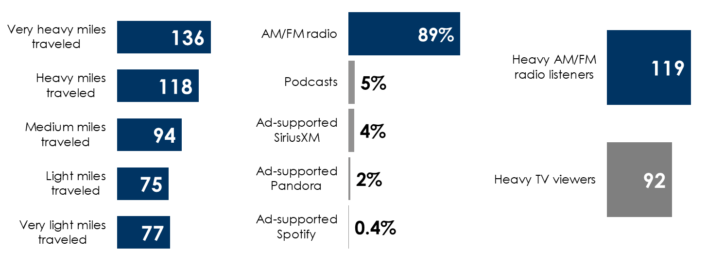
AM/FM radio works for auto dealers
Auto intenders clock a lot of miles: Heaviest miles traveled segment 36% more likely to be in market
AM/FM radio rules ad-supported audio in the car
Heavy AM/FM radio listeners are 19% more likely to be auto intenders; heavy TV viewers 8% less likley
Household plans to buy a new vehicle in the next 12 months indexed to the total U.S.
Share of ad-supported audio time spent in the car among persons 18+
Household plans to buy a new vehicle in the next 12 months indexed to the total U.S.
INSERT STATION LOGO HERE
Source: Left: Scarborough, Podcast Recontact Study (USA+) 2022 Release 1 Total (November 2022), Total Adults 18+ Projected: 259,044,221 Respondents: 199,118; Middle: Edison Research, "Share of Ear,” Q4 2021-Q3 2022. Persons 18+, in the car; SiriusXM: Ad-supported: Spoken Word. Ad-free: Music; Percentages may not add up to 100 due to rounding; Right: Scarborough USA+ 2022 Release 1 Total (Dec 2020 - Apr 2022); Podcast Recontact Study (USA+) 2022 Release 1 Total (November 2022); Base: Total Adults 18+ Projected: 259,044,221 Respondents: 199,118

