Slide 1
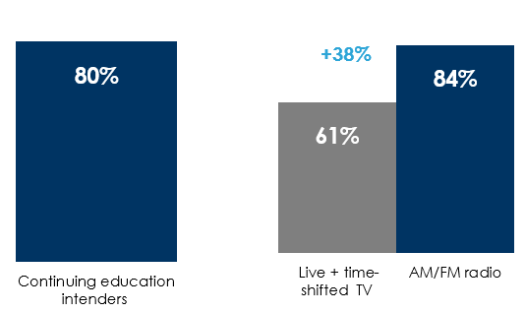
AM/FM radio delivers prospective students
Those who intend to continue education are predominately 18-49
Nielsen weekly reach: AM/FM radio is #1 among adults 18-49 with a +38% advantage over TV
Prospective students listen to a variety of AM/FM radio formats
% of intenders adults 18-49
Adults 18-49 weekly reach (% of population)
% of prospective students – frequently or occasionally listen to AM/FM radio formats
Rock | 49%
Oldies/Classic Hits | 48%
Adult Contemporary | 47%
Classic Rock | 46%
Top 40 | 46%
Alternative | 38%
R&B & Hip Hop | 38%
Country | 35%
News/Talk | 34%
Sports | 27%
National Public Radio (NPR) | 24%
Christian / Religious | 22%
Spanish | 17%
Source: Left: MARU/Matchbox Education Study – August 2022; Continuing education intenders: Definitely willing to consider or planning to go back to school in the next year. Online education intenders: Definitely willing to consider or planning to begin online education in the next year; Middle: Nielsen Total Audience Report Q2 2022. Podcast: Edison Research Infinite Dial 2022; Right: MARU/Matchbox Education Study – August 2022; Q: How frequently do you listen to each of the following radio formats?; Prospective students: might consider, definitely willing, or planning to go back to school. Prospective online students: Might consider, definitely willing, or planning to begin online education.
INSERT STATION LOGO HERE

