Slide 1
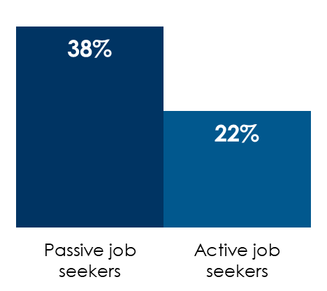
AM/FM radio works for recruitment, reaching passive and active job seekers
Passive job seekers are the #1 source of new workers in America and outnumber active job seekers two to one
AM/FM radio reaches passive and active job seekers
A wide variety of AM/FM radio programming formats can be used to reach passive job seekers
77% of passive job seekers and 76% of active job seekers listened to AM/FM radio in the past month
43% of passive job seekers and 51% of active job seekers have listened to AM/FM radio streaming
% of passive job seekers who frequently listen
Oldies/Classic Hits 45%
Classic Rock 44%
Rock 44%
Adults Contemp. 42%
Top 40 42%
News/Talk 33%
Country 33%
Alternative 29%
RAB/Hip Hop 28%
Sports 26%
Q: Of the following statements, which one best describes your current job situation?
INSERT STATION LOGO HERE
Source: MARU/Matchbox National Study – July 2022, 1,000 total respondents; Left: Q: Of the following statements, which one best describes your current job situation? Middle: Q: When is the most recent time, if ever, you spent time doing the following types of activities?; Right: Q: How frequently do you listen to each of the following radio formats?

