Slide 1
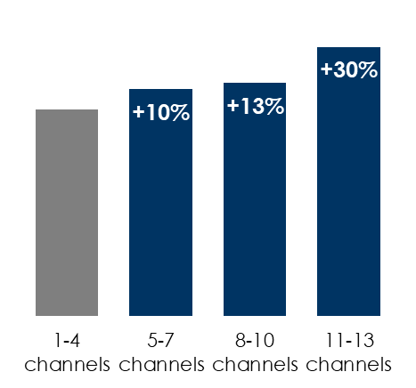
AM/FM radio and digital work together
As more advertising channels are used, effectiveness goes up
Adding AM/FM radio to digital-only campaigns generates significant incremental reach
Adding online video and social to AM/FM radio campaigns delivers incremental reach
Incremental effectiveness by adding media platforms
Adding AM/FM radio to a digital-only plan for a 20% additional investment generated a
+38%
increase in campaign reach
Adding digital to an AM/FM radio plan for a 20% additional investment generated a
+20%
increase in campaign reach
Source: Left: The Effectiveness Code, by James Hurman with Peter Field, Cannes Lions and WARC by Ascential; Middle: Nielsen Media Impact March 2022, adults 25-54: Network Radio reach based on all network affiliated radio stations at an average CPP of $5000. Digital reach based on desktop, mobile, and tablet at an average CPM of $10; Right: Nielsen Commspoint US 2022; AM/FM radio CPPs: A25-54 - $9,500; Social: Commspoint US 2022 default CPPs – Spend evenly split between Facebook, YouTube, Twitter, Instagram
INSERT STATION LOGO HERE

