Slide 1
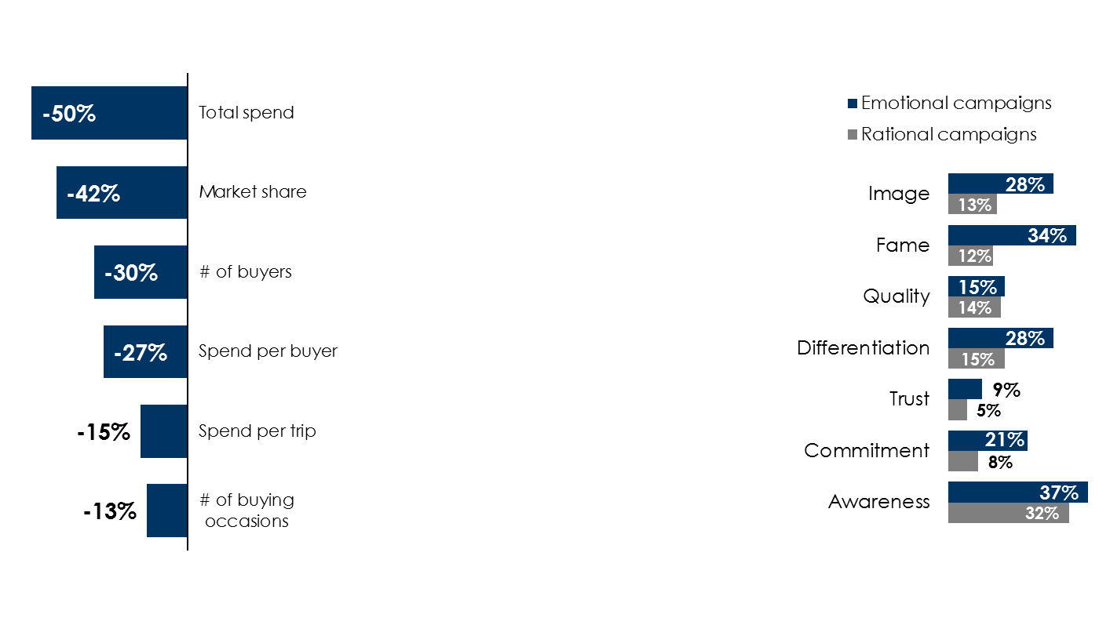
Marketing strategies for an uncertain economy
Continue to advertise
More branding, less sales
Creative – the more they feel, the more they buy
Sales fall when a brand stops advertising: % difference, unexposed vs. exposed
Convert existing demand: Making sure advertising targets the relatively small group of consumers who are ready to buy and capturing as large a share as possible of them for a product.
Create future demand: Advertising to that much larger group of consumers who are not ready to buy now, but will be in the future, and making them feel familiar with and positively toward the brand, so that they gravitate to them when they enter the category.
% reporting very large effects on intermediate brand metrics
Source: Left: Nielsen Buyer Insights (NBI), Sales Effectiveness Analysis, Auto Aftermarket Retailer, Persons 18+. Unexposed: 12,329; Exposed: 14,147. Pre-period = 3/1/15-6/30/15. Test period = 3/1/16-6/28/16; Middle: "Rethinking Brand For The Rise Of Digital Commerce" World Advertising Research Center (WARC) 2021 by James Hurman, Founding Partner of Previously Unavailable; Right: The Long and the Short of It: Balancing Short and Long-Term Marketing Strategies; Les Binet, Head of Effectiveness, adam&eve DDB & Peter Field, Marketing Consultant
INSERT STATION LOGO HERE

