Slide 1
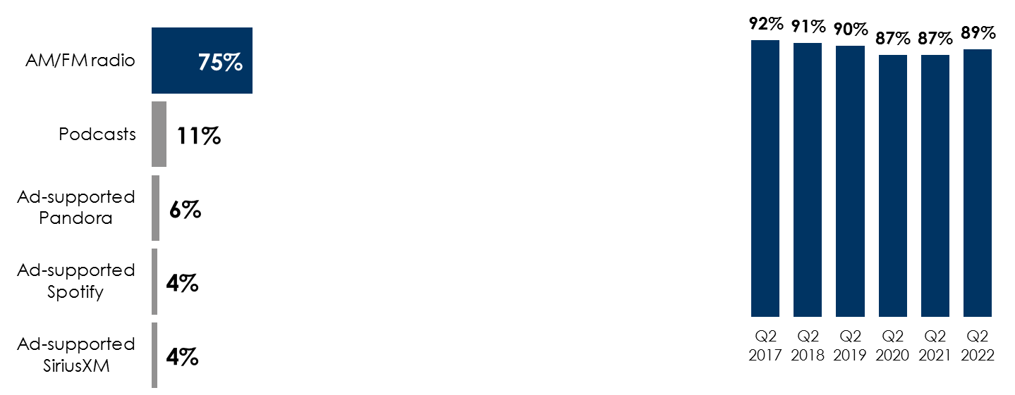
“Share Of Ear” Q2 2022: AM/FM Radio Continues To Dominate Ad-Supported Audio
AM/FM radio dominates
ad-supported audio
AM/FM radio has substantial shares among registered voters, Independents, Republicans, and Democrats
AM/FM radio’s in-car
ad-supported shares have been steady over the past six years
Share of ad-supported audio time spent among persons 18+
Share of ad-supported audio time spent among persons 18+
AM/FM radio’s share of ad-supported audio in the car among persons 18+
 | Registered voters | Democrats | Independents | Republicans
AM/FM radio | 76% | 73% | 75% | 78%
Podcasts | 11% | 13% | 11% | 9%
Ad-supported Pandora | 5% | 6% | 6% | 6%
Ad-supported SiriusXM | 4% | 5% | 4% | 5%
Ad-supported Spotify | 3% | 4% | 4% | 2%
INSERT STATION LOGO HERE
Source: Left: Edison Research, "Share of Ear,” Q3 2021-Q2 2022. Persons 18+; SiriusXM: Ad-Supported: Spoken Word. Ad-Free: Music. Middle: Edison Research, "Share of Ear,” Q3 2021-Q2 2022. Persons 18+; SiriusXM: Ad-Supported: Spoken Word. Ad-Free: Music; Party affiliation is self-identified. Right: Edison Research, "Share of Ear,” Persons 18+ in the car, Q2 2017-Q2 2022.

