Slide 1
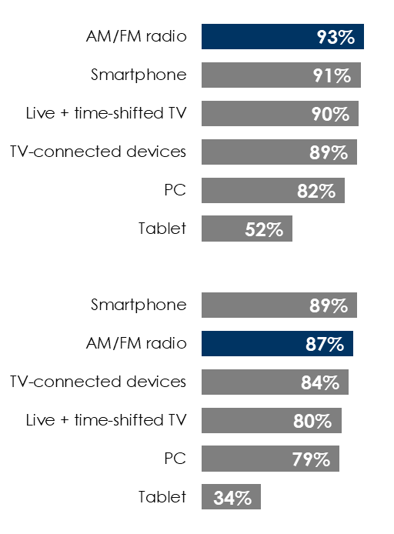
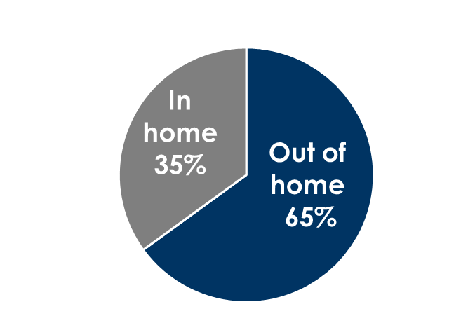
Nielsen: AM/FM Radio Is At The Center Of The Audio Universe With Massive Reach, Delivering Consumers On The Path To Purchase
AM/FM radio outreaches TV monthly
Two-thirds of all AM/FM radio listening occurs away from home on the path to purchase
AM/FM radio listeners are fueling the post-pandemic economy
Monthly reach among adults 18-34
Heavy AM/FM radio listeners have +26% greater purchase intentions than heavy TV viewers
% of AM/FM radio listening by location
Monthly reach among adults 35-49
INSERT STATION LOGO HERE
Source: Left: Nielsen NPOWER, Nielsen RADAR, Nielsen Total Media Fusion – Q4 2021; Middle: Nielsen National Regional Database, Adults 18+, Audio Diary markets only, Q4 2021; Right: Custom Nielsen study conducted March 2022 via an online survey, based on a weighted sample of 1000 among P18+

