Slide 1
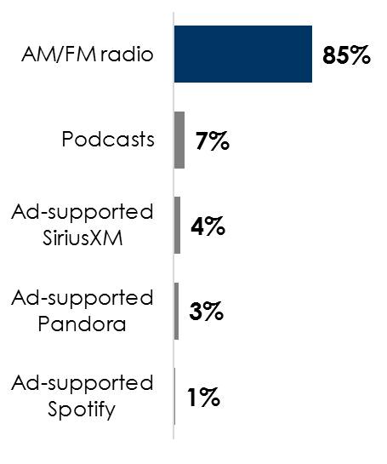
AM/FM Radio Works For Auto Dealers As TV Audiences Disappear
Cord cutting is a major driver of TV’s audience collapse
AM/FM radio leads ad-supported audio in the car
AM/FM radio campaigns generate significant auto dealer website traffic
In-car share of ad-supported audio time spent among persons 18-49
46% of the U.S. households have cut the cable cord
AM/FM radio drives a
+17%
lift in automotive web traffic on average
40+
AM/FM radio ads in one day in a market generate 11X site traffic lift of 1-9 ads
Nielsen: Since 2018, TV’s 25-54 reach has dropped to 72% and ratings are down -34%
Source: Left: MRI Simmons, How Americans Watch TV, 2021 November Cord Evolution, Base: Total Population | Cord Groups & Nielsen: Total Audience Report Q2 2021; Middle: Edison Research, "Share of Ear,” Q1-Q4 2021, in the car; SiriusXM: Ad-Supported: Spoken Word. Ad-Free: Music; Right: LeadsRx and iHeartMedia Automotive Radio Attribution Study, 2019; N = 310 automotive advertisers in 100 markets, 19 brands, Jan 2018 - May 2019.
INSERT STATION LOGO HERE

