Slide 1
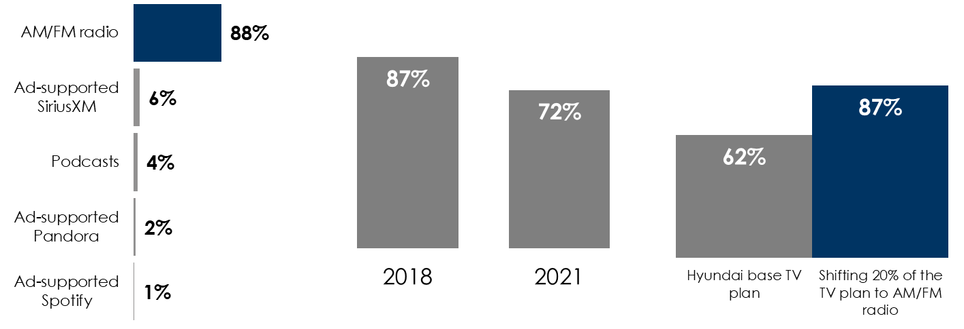
As TV Audiences Disappear, AM/FM Radio Works For Auto Dealers
AM/FM radio rules ad-supported audio in the car
Since 2018, TV’s reach among persons 25-54 has dropped to 72%
Shifting 20% of the linear TV budget to AM/FM radio dramatically increases reach
Share of ad-supported audio time spent in the car among persons 18+
Persons 25-54 weekly reach
Nielsen: Persons 25-54 reached, September 2021, Dallas-Ft. Worth, TX
-17%
+40%
INSERT STATION LOGO HERE
Source: Left: Edison Research, "Share of Ear,” Q1-Q4 2021. Persons 18+, in the car; SiriusXM: Ad-supported: Spoken Word. Ad-free: Music; Percentages may not add up to 100 due to rounding.; Middle: Nielsen Total Audience Report, Q2 2021; Right: Local Nielsen Media Impact Fusion, Hyundai, Persons 25-54 reached, September 2021, Dallas-Ft. Worth, TX

