Slide 1
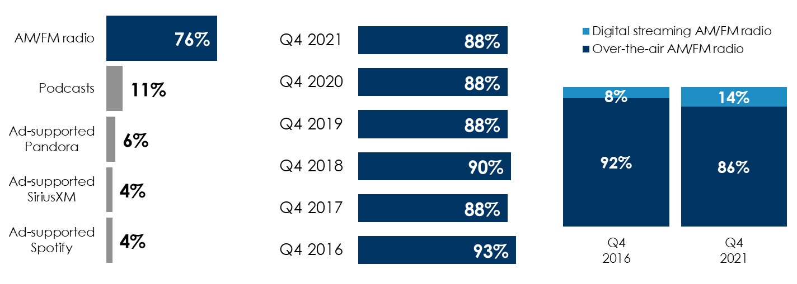
Edison Research’s “Share Of Ear” Q4 2021: AM/FM Radio Has A Dominant Ad-Supported Share And AM/FM Radio Streaming Has Surged
AM/FM radio dominates ad-supported audio shares
In the car, AM/FM radio ad-supported shares have hovered in the high 80s for the last six years
Over six years, the proportion of AM/FM radio listening occurring via online streaming has surged from 8% to 14%
Share of audio time spent between over-the-air AM/FM radio listening and digital streaming AM/FM radio listening, persons 25-54
Share of ad-supported audio time spent among persons 18+
AM/FM radio’s share of ad-supported audio in the car among persons 18+
Source: Left: Edison Research, "Share of Ear,” Q4 2019 – Q4 2021. Persons 18+; SiriusXM: Ad-Supported: Spoken Word. Ad-Free: Music. Middle: Edison Research, "Share of Ear,” Persons 18+ in the car, Q4 2016-Q4 2021. Right: Edison Research, "Share of Ear,” Q4 2016 – Q4 2021; Persons 25-54.
INSERT STATION LOGO HERE

