Slide 1
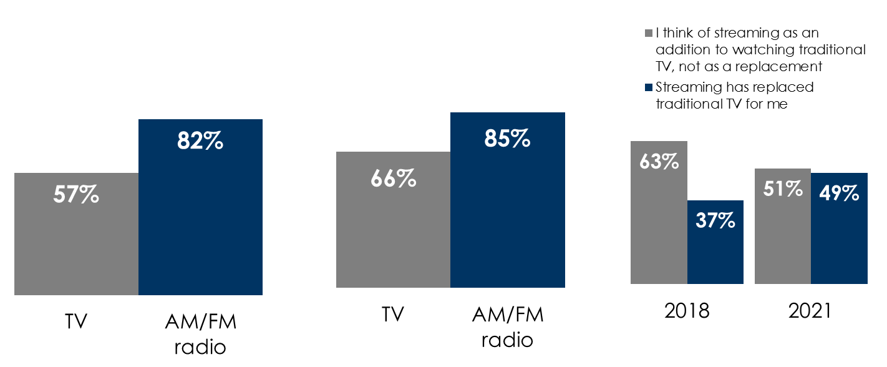
AM/FM Radio Is Overtaking Traditional TV As More Americans Turn To Streaming
AM/FM radio’s outreaches TV by +44% among persons 18-34
AM/FM radio outreaches TV by +29%
among persons 18-49
Nearly half of all streamers feel it has replaced traditional TV
Q: Which of the following statements best describes how you feel…
Persons 18-34 weekly reach % of U.S. population
Q2 2021
Persons 18-49 weekly reach % of U.S. population
Q2 2021
Source: Left: Nielsen Total Audience Report, Persons 18-34 weekly reach % of users of live + time-shifted TV among U.S. population; Middle: Nielsen Total Audience Report, Persons 18-49 weekly reach % of users of live + time-shifted TV among U.S. population; Right: MRI Simmons, How Americans Watch TV, 2021 November Cord Evolution, Base: Streamers
INSERT STATION LOGO HERE

