Slide 1
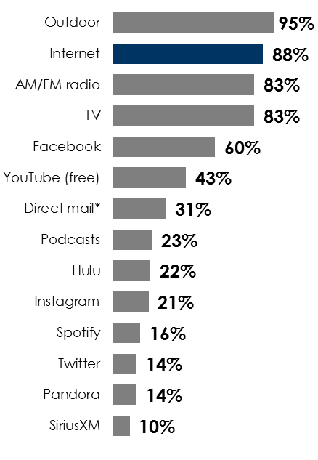
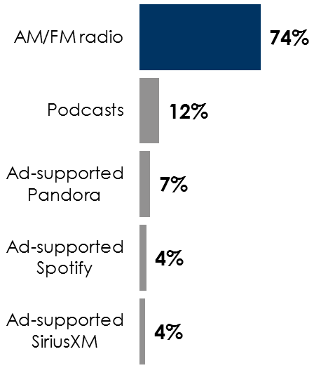
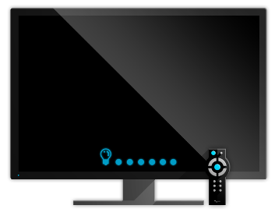
Now Is The Time: Reach Voters With AM/FM Radio
AM/FM radio and digital reach almost all registered voters
AM/FM radio supplements cable TV audience losses
AM/FM radio dominates audio share among registered voters
% of registered voters reached
Share of ad-supported audio time spent among persons 18+
(among registered voters)
AM/FM radio reaches
47.7M
non-pay TV consumers who do not see cable ads
Nielsen Scarborough USA+ 2021 Release 1 Total (Jan 2020– May 2021), Outdoor/Radio/TV/Internet/Pandora/Spotify/SiriusXM/Hulu/YouTube: used in last 7 days. Facebook/Instagram/Twitter: used in past 30 days. Outdoor defined as Any miles traveled in car, van, truck or bus last 7 days. *Direct mail/Coupons in mail defined as How household usually obtains coupons (HHLD): Mail. Podcast source: Podcast Recontact Study (USA+) 2020 Release 2 Total (May 2021); Middle: Spring 2021 MRI-Simmons USA; Right: Edison Research, “Share of Ear,” Q3-Q4 2020, Q1-Q2 2021. Persons 18+; SiriusXM: Ad-Supported: Spoken Word. Ad-Free: Music; Party affiliation is self-identified.
INSERT STATION LOGO HERE

