Slide 1
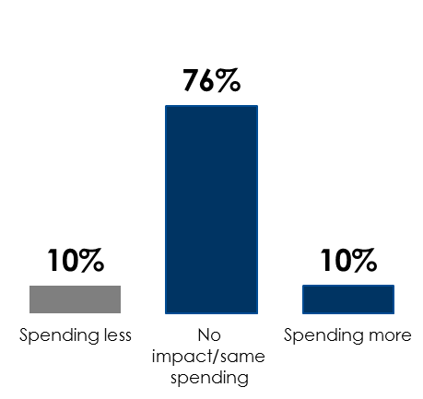
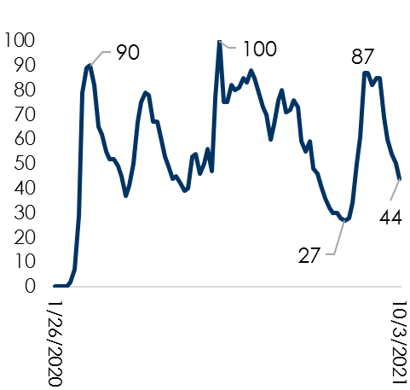
America Continues Reemergence From Pandemic: Nielsen AM/FM Radio Audiences Grow, COVID Concerns Drop, And Consumer Spending Is Steady
Nielsen: PPM listening reached a record high and Diary markets show no COVID impact
Google Trends: October 2021, COVID Google searches are down -56% from peak consumer interest
Nielsen: Consumer spending is steady despite the Delta variant as 86% are spending the same/more
Google search interest in the term “COVID” by week over time:
Numbers represent search interest relative to the highest point on the chart for the given region and time (100 is the peak popularity for the term)
Percent spending more, less, or about the same since the Delta variant emerged
AM/FM radio retained
94%
of its AQH audience in September 2021 compared to March 2020 levels in PPM markets and
100%
of its AQH audience in August 2021 compared to March 2020 levels in diary markets
86%
Source: Left: Nielsen March 2020-September 2021 PPM / 45 Market Total / M-Su 6a-12M / Persons 12+ / AQH Persons (Persons Using AM/FM Radio), Nielsen January 2020-August 2021 CDM / 44 Market Total / M-Su 6a-12M / Persons 12+ / AQH Persons (Persons Using Radio); Middle: Google Trends Report; Right: Custom Nielsen study conducted September 2021 via an online survey, based on a weighted sample of 1022 among P18+
INSERT STATION LOGO HERE

