Slide 1
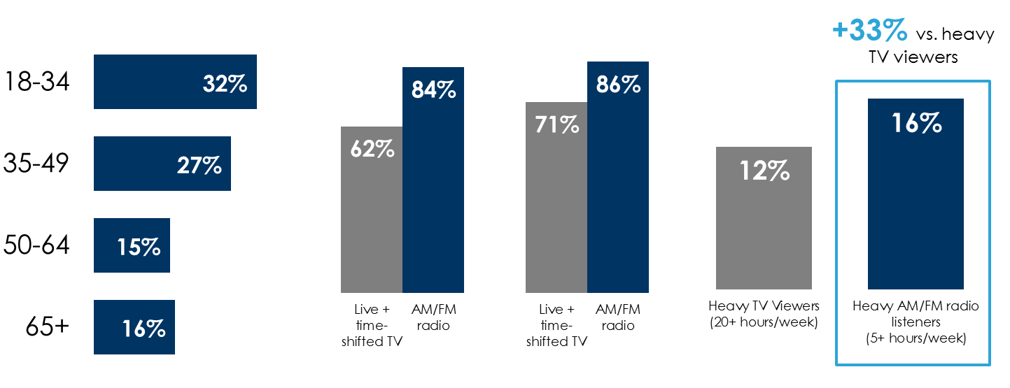
AM/FM radio is the ideal marketing platform for law firms and attorneys
The age profile of those in the market for legal services aligns well with AM/FM radio and skews much younger than TV
Nielsen: AM/FM radio outreaches TV among younger demographics likely to hire an attorney
Heavy AM/FM radio listeners are +33% more likely to have hired a personal injury law firm compared to heavy TV viewers
Audience composition of those who say they would “definitely likely” hire a personal injury law firm if they were injured in a car accident
Weekly reach of live + time-shifted TV and AM/FM radio
Q: “Have you ever hired a personal injury attorney?” (% of respondents who answered “yes”)
Persons 18-34
Persons 18-49
Source: Left: MARU/Matchbox Personal Injury Law Firm Study – May 2021, 505 total respondents; Middle: Nielsen Total Audience Report Q4 2020; Right: MARU/Matchbox Personal Injury Law Firm Study – May 2021, 505 total respondents. Q: “Have you ever hired a personal injury attorney?”
INSERT STATION LOGO HERE

