Slide 1
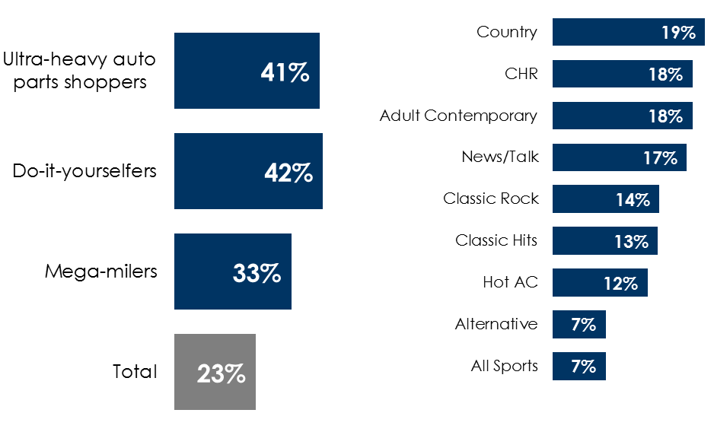
AM/FM radio is the ideal marketing platform for auto aftermarket retailers
AM/FM radio is a stronger platform than TV for auto parts and accessories retailers
Key auto parts shopper segments are far more likely to be heavy AM/FM radio listeners
A wide variety of AM/FM radio programming formats generate strong reach with auto parts purchasers
Versus TV, AM/FM radio listeners shop more often, spend more, buy from more retailers and are more engaged with auto aftermarket brands
% of respondents who are heavy AM/FM radio listeners (listen to AM/FM radio 9+ hours per week)
AM/FM radio format weekly reach % among auto parts shoppers in the last 12 months
 | Heavy AM/FM radio listeners | Heavy TV viewers
Average # of shopping trips | 8.4 | 5.5
Average retailers shopped | 3.6 | 2.3
% of stimulus spent on auto parts | 25% | 8%
Average spend last year | $935 | $629
Average brand ad recall | 29% | 19%
INSERT STATION LOGO HERE
Source: Left/Middle: MARU/Matchbox April 2021 National Study; Right: Scarborough USA+ 2020 Release 2 *Revised 04-20-2021 (July 2019 – September 2020)

