Slide 1
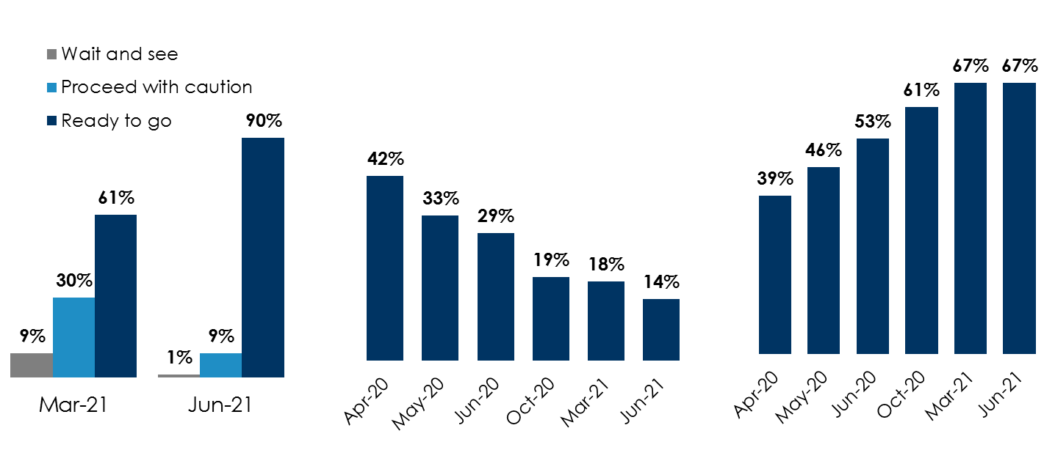
Nielsen Consumer Study: Americans are “ready to go” and commuting to work outside the home
Nine in ten consumers are now ready to go
Workers at home due to COVID-19 declined by more than two-thirds since April 2020
Among those employed, two-thirds now work outside the home, up nearly +70% since April
+29 point jump from March 2021 to June 2021 among the “ready to go” segment
% of at-home workers due to COVID-19
% of employed persons working
outside the home
Source: Left: Custom Nielsen study conducted March 2021 & June 2021 via an online survey among P18+; Middle: Custom Nielsen study conducted April 2020, May 2020, June 2020, October 2020, March 2021 & June 2021 via an online survey among P18+; Employed persons: Those who stopped going to their workplace when COVID-19 started and do not plan to go back for the foreseeable future & those who plan to go back soon; Right: Custom Nielsen study conducted April 2020, May 2020, June 2020, October 2020, March 2021 & June 2021 via an online survey among P18+. Employed persons: Continue to work outside the home; Stopped going into the workplace when COVID-19 started but have recently started to go back in; Furloughed or laid off but have since gone back to work, For those who said they were “furloughed or laid off and have since gone back to work” assumes the same ratio of those who work outside the home (52%) as the total employed population
INSERT STATION LOGO HERE

