Slide 1
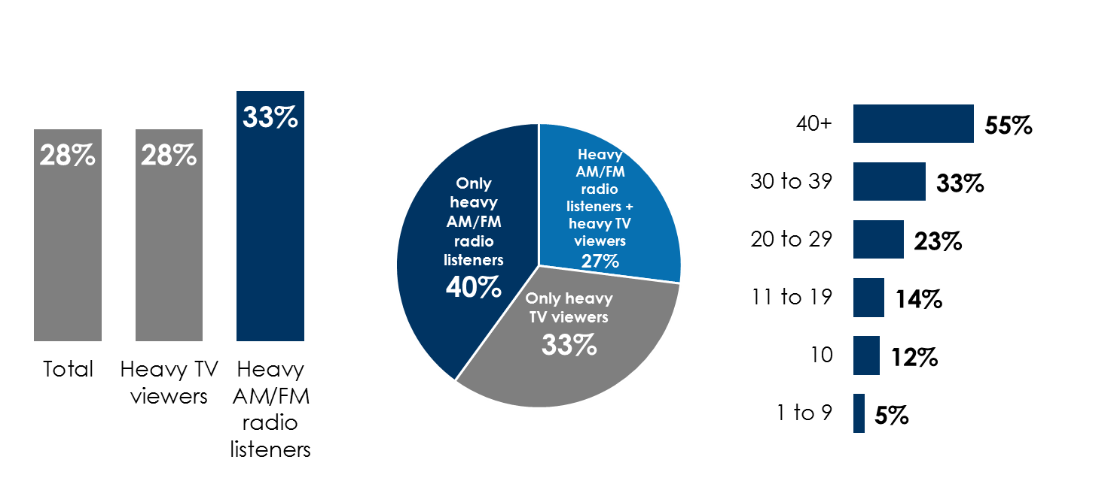
AM/FM radio works for the auto industry
Heavy AM/FM radio listeners are +18% more likely to make a major auto purchase in the next 12 months
40% of those who are looking to buy a new car are much easier to reach on AM/FM and nearly impossible to reach on TV
As the number of daily AM/FM radio ads increases, auto dealer website traffic lift surges
% who intend to purchase or lease a new/used vehicle in the next 12 months
% of households that plan to buy a new vehicle in the next 12 months among heavy AM/FM radio and TV users
% auto dealer website traffic lift based on average # of AM/FM radio ads run daily in a market
Source: Left: Custom Nielsen study conducted March 2021 via an online survey, based on a weighted sample of 1009 among P18+; Middle: Scarborough USA+ 2020 Release 2 *Revised 03-26-2021* Total (Jul 2019 - Sep 2020), Adults 18+; Right: LeadsRx and iHeartMedia Automotive Radio Attribution Study, 2019; N = 310 automotive advertisers in 100 markets, 19 brands, Jan 2018 - May 2019.
INSERT STATION LOGO HERE

