Slide 1
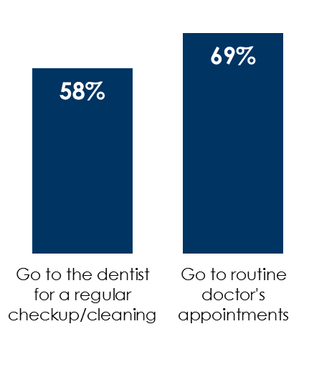
AM/FM radio works for healthcare
Consumers are resuming routine healthcare appointments
AM/FM radio has massive reach among those who are insured
AM/FM radio listeners take action after hearing healthcare ads
% of adults 18+ very/somewhat likely to do the following in next two months
86%
of adults 18+ who have purchased non-prescription drugs after being exposed to a healthcare ad have listened to AM/FM radio
85%
of adults 18+ with health insurance are AM/FM radio listeners and
40%
are heavy AM/FM radio listeners
85%
of adults 18+ who have made an appointment with a doctor after being exposed to a healthcare ad have listened to AM/FM radio
INSERT STATION LOGO HERE
Source: Left: Custom Nielsen study conducted March 2021 via an online survey among adults 18+; Middle & Right: Scarborough USA+ 2020 Release 2 Total (Jul 2019-Sep 2020). Adults 18+. Total Radio MSU 6a-12a cume, Heavy Radio listeners (1st or 2nd quintile)

