Slide 1
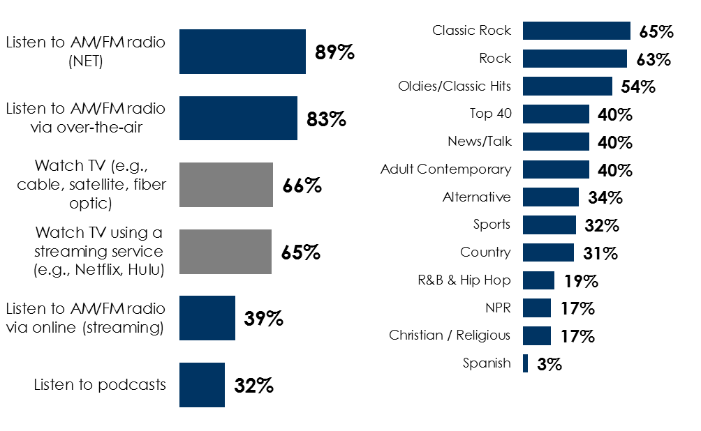

AM/FM radio reaches the passive job seeker
Passive job seekers are a huge source of new workers
Passive job seekers listen to AM/FM radio
Passive job seekers listen to a variety of AM/FM radio formats
% of passive job seekers who do the following regularly
% of passive job seekers who listen frequently or occasionally
When asked to describe their current job situation
51%
of heavy AM/FM radio listeners and
56%
of heavy AM/FM radio streamers consider themselves passive job seekers
INSERT STATION LOGO HERE
Source: MARU/Matchbox National Study, February 8-24, 2021, 969 respondents

