Slide 1
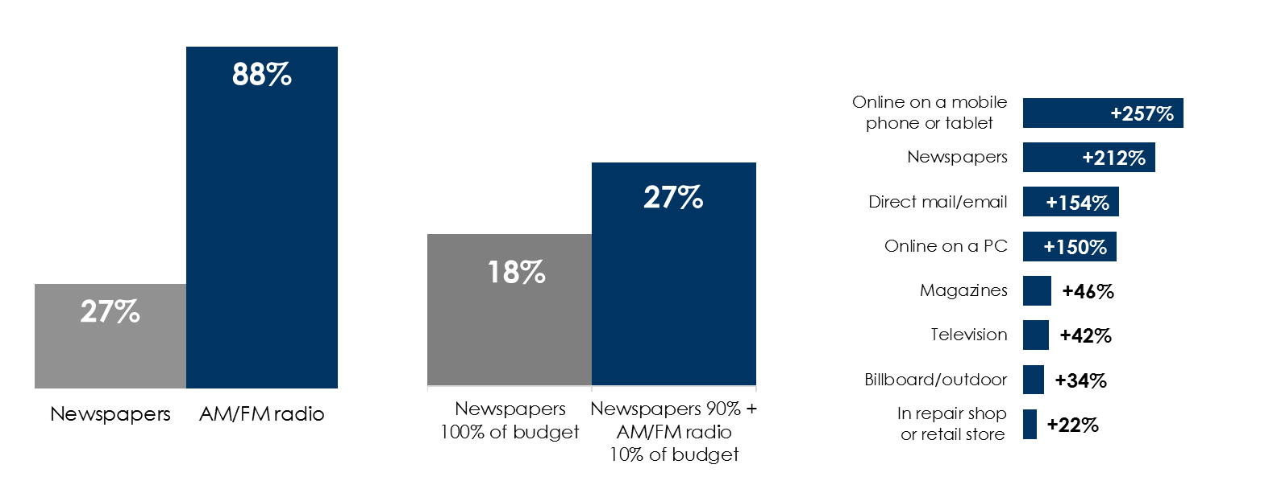
AM/FM radio makes newspaper ads better
AM/FM radio outreaches newspapers
Adding AM/FM radio to the newspaper plan generates incremental reach
AM/FM radio elevates awareness of the entire media plan
% of adults 18+ reached weekly
% monthly reach among adults 25-54
% increase between unexposed and exposed to AM/FM radio groups
Q: Where else have you seen or heard advertising recently for the auto parts manufacturer brand?
Shifting 10% of the newspaper budget to AM/FM radio yields +50% in incremental reach
+50%
Source: Left: AM/FM radio: Nielsen Audio Total Audience Report Q3 2020, Newspaper: Scarborough USA+ 2020 Release 2 Current 6 months Only (Jan 2020 – Sept 2020), Newspaper: read 1+ print edition in an average week; Middle: Nielsen Commspoint Influence – June 2020, adults 25-54; Right: Nielsen Campaign Effect: Measuring the Impact of Advertising on Brand Metrics. April 2016.
INSERT STATION LOGO HERE

