Slide 1
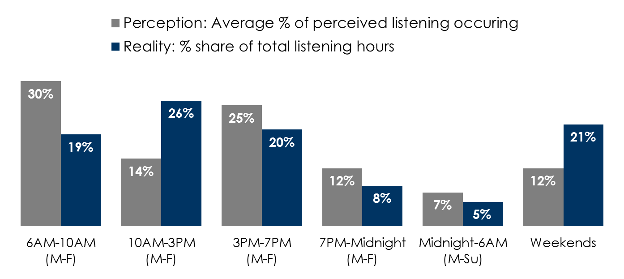
Perception vs. reality: 61% of AM/FM radio listening occurs outside of drive times; Middays and weekends are far stronger than advertisers perceive
Q: Thinking about traditional AM/FM radio, to the best of your knowledge, please indicate what percentage of listening occurs in each of the time slots listed below.
Source: Perception: Perception: Advertiser Perceptions December 2020, 300 respondents. Reality: Nielsen Audio, Persons Using Radio, Oct-Nov-Dec 2020 (PPM), Jul-Aug-Sep (CDM Diary), adults 25-54, total listening hours.
INSERT STATION LOGO HERE

