Slide 1
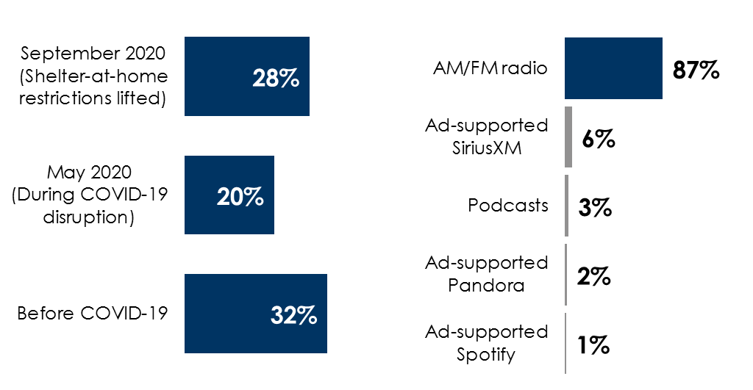
AM/FM radio audiences in the car rebound
AM/FM radio’s in-car share returns to
pre-pandemic levels
AM/FM radio has the #1 share of ad-supported audio in the car
AQH listening out of the home is near March levels
% of audio time spent in the car among persons 13+
Share of ad-supported audio time spent in-car among persons 18+
67%
of average
quarter-hour listening in PPM markets takes place out of the home, nearing March’s 71% level
INSERT STATION LOGO HERE
Source: Column 1: Edison Research, “Share of Ear” 2020; Column 2: Edison Research, “Share of Ear,” Q3 2020. Persons 18+; Column 3: Nielsen November 2020 PPM / 45 Market Total / M-F 6a-7p / Persons 18+ / AQH Persons by Location

