Slide 1
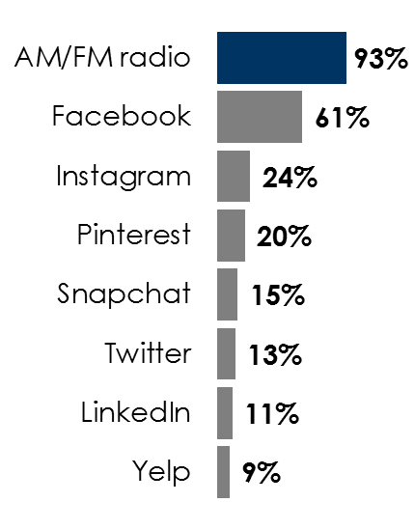
AM/FM radio makes Facebook ads better
Massive reach
Reach 52% more consumers
than Facebook with AM/FM radio
Engaging content
AM/FM radio ads are noticed
Greater daily time spent
Ads are exposed more frequently
Monthly persons 18+ reach
Concentration with news and weather is over
1.5X
social media
Persons 25-54 spend
1.5X
daily time with AM/FM radio versus social media on a smartphone
News and weather engagement is
2X
social media
Source: Massive reach: AM/FM radio reach: Nielsen Audio Spring 2020-Fall 2019 Nationwide, MS 12m-12m, 4-week reach based on 672 spots per week (equal to number of quarter-hours), All radio stations as of 10/06/2020, Adults 18+; Social platforms reach: Scarborough USA+ 2020 Release 1 Total (Jan 2019 - May 2020), Internet sites/apps visited in last 30 days; Engaging content: IAB Research Using MARU/Matchbox’s Springboard America Online Panel, Representative of General US Ages 18+ Online Population, January 2018; Time spent: Nielsen Total Audience Report Q1 2020
INSERT STATION LOGO HERE

