Slide 1
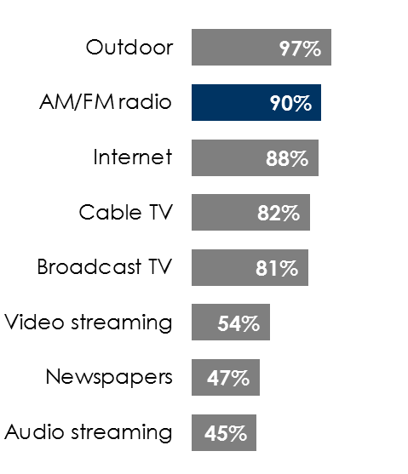
AM/FM radio works for auto dealers
Recovery to pre-pandemic levels
Huge audience
Massive reach
% of in-market auto buyers reached weekly
17M
According to J.D. Power, new auto sales for the week ending 8/30 were only down -4% from the pre-virus forecast, improving significantly from the -59% decline seen at the end of March
of Americans plan to buy a new vehicle in the next 12 months at an average price of
$27K
INSERT STATION LOGO HERE
Source: Column 1: COVID-19: J.D. Power Industry Impact Report 2020; Column 2 & Column 3: Nielsen Scarborough USA+ 2020 Release 1 Total (Jan 2019 – May 2020), Base: Adults 18+, Vehicle HHLD plans to buy new next 12 months (HHLD) Any New Vehicle

