Slide 1
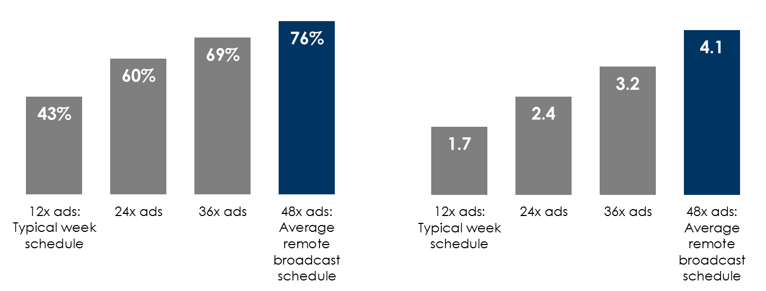
An average remote broadcast media schedule achieves massive audience reach and generates significant frequency
% station audience reached by a one week schedule
Campaign frequency generated among station listeners by a one week schedule
INSERT STATION LOGO HERE
Source: Nielsen Nationwide Fall/Spring 2019, adults 25-54

