Slide 1
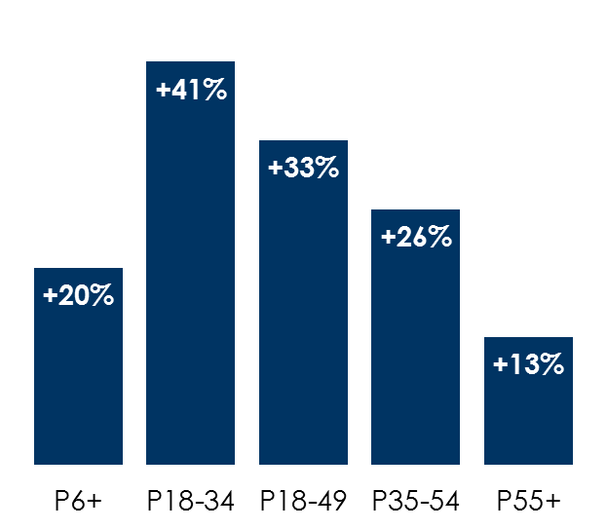
Nielsen case studies: AM/FM radio makes your TV better by adding significant incremental reach across various categories and demographics
 | Incremental reach by age
Category | P6+ | P18-34 | P18-49 | P35-54 | P55+
Quick service restaurant | +31% | +46% | +30% | +32% | +31%
Home improvement retailer* | +18% | +42% | +35% | +25% | +11%
Courier services | +18% | +39% | +33% | +24% | +9%
Wireless | +17% | +35% | +30% | +22% | +8%
Retailer | +18% | +41% | +37% | +30% | +10%
Average incremental reach by age
How to read: For a quick service restaurant, AM/FM radio boosted reach +46% among new/different persons 18-34 who were not reached by the TV buy.
INSERT STATION LOGO HERE
Source: Nielsen PPM Custom Analysis, Aggregate of Incremental Reach Studies conducted in 2019/2020; *Home Improvement reflects P35-64, not P35-54

