Slide 1
Heavy AM/FM radio listeners are likely to spend more
Intend to spend more money than they are now once restrictions are eased (within 2 months) | Total | Heavy TV viewers | Heavy AM/FM radio listeners
Grocery/warehouse stores | 57% | 57% | 65%
Gas station | 57% | 43% | 53%
Takeout from restaurant or fast food | 54% | 52% | 57%
Dining out at a restaurant | 43% | 39% | 46%
Convenience stores | 42% | 39% | 48%
Hardware/home improvement | 27% | 21% | 35%
Lawn care/landscaping | 23% | 21% | 28%
Liquor stores | 22% | 17% | 29%
Laundry/dry cleaners | 22% | 22% | 25%
Auto repair | 21% | 17% | 25%
Financial services (bank/investments) | 21% | 16% | 23%
Intend to spend more money than they are now once restrictions are eased (within 2 months) | Total | Heavy TV viewers | Heavy AM/FM radio listeners
Auto parts store | 19% | 19% | 27%
Remodeling/home improvements | 18% | 16% | 28%
Insurance | 17% | 11% | 21%
Cleaning service | 14% | 12% | 22%
Furniture | 12% | 8% | 18%
Accounting/CPA/tax prep | 12% | 11% | 14%
Hotel reservations | 12% | 6% | 11%
Electrical | 11% | 6% | 15%
Plumbing/HVAC | 10% | 9% | 11%
Legal services | 9% | 7% | 10%
Air travel | 8% | 4% | 12%
Car rental | 7% | 4% | 11%
INSERT STATION LOGO HERE
Source: Custom Nielsen study conducted April 30-May 2 via an online survey, based on a weighted sample of 1000 persons 18+

Slide 2
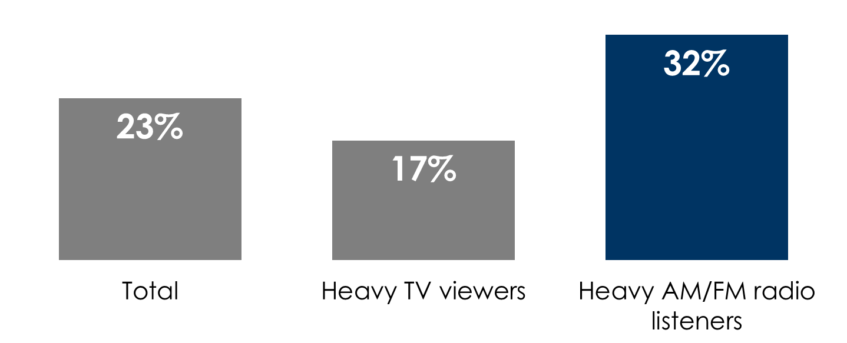
Heavy AM/FM radio listeners are more likely to make a major auto purchase in the next 12 months
Q: How soon after the restrictions are eased would you make that postponed major purchase?
(Base = postponed major purchase)
% who intend to purchase or lease a new/used vehicle in the next 12 months
INSERT STATION LOGO HERE
Source: Custom Nielsen study conducted April 30-May 2 via an online survey, based on a weighted sample of 1000 persons 18+

