Slide 1
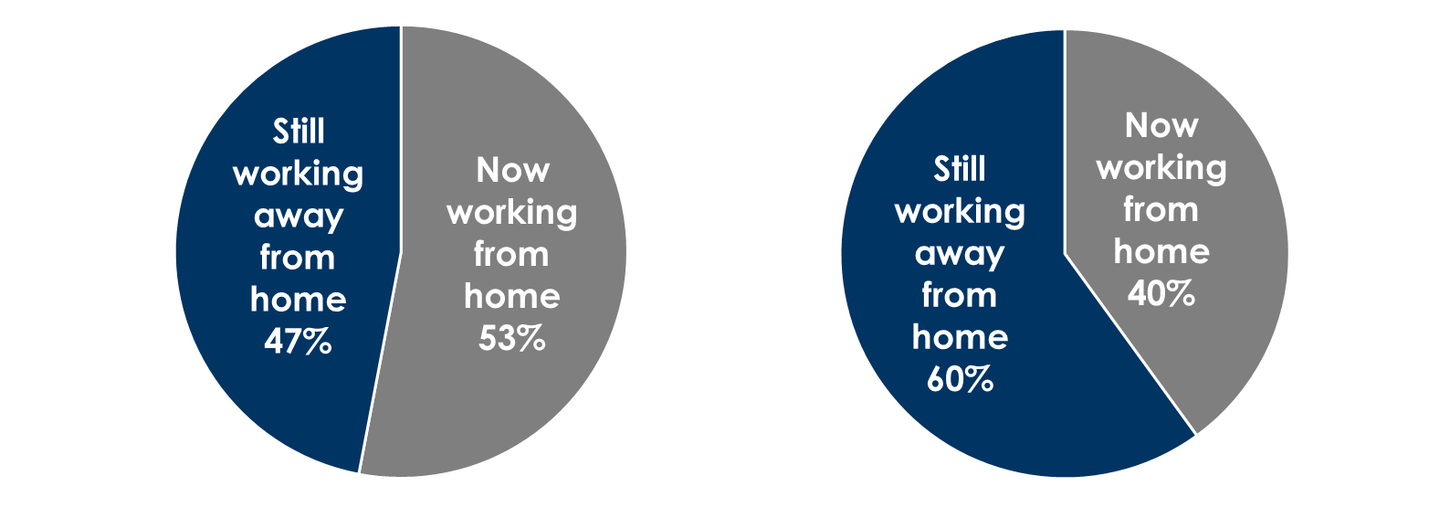
Think everyone is working from home? Think again!
47% of Americans who usually work away from home are still working away from home
60% of heavy AM/FM radio listeners who usually work away from home are still working away from home
Among those who normally work away from home
Among heavy AM/FM radio listeners (11+ hours/week) who normally work away from home
INSERT STATION LOGO HERE
Source: Westwood One Community survey of 1,154 adults 18+, March 31- April 8, 2020.

